Slide 1
Pre-Arrival Money Masterclass
Welcome 2023
Notes:
Welcome to our pre-arrival talk on all things money and finance. Starting university is a really exciting time, but this might be the first time that you’re managing your own money and that can be quite scary.

Slide 2
What will we cover?
UK Student Finance
Bursaries and scholarships
Student bank accounts
Budgeting
Increasing income and cutting costs
Financial support
Online Blackbullion platform
Tips from current students
Notes:
Over the next 45 minutes or so, we’ll be covering a variety of money-related topics that you will need to know before you start your course with us. If you have any questions at any point, please pop them in the chat – you should find a chat icon at the top or bottom of your screen depending on which device you’re using.

Slide 3
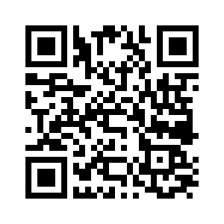
UK Student Finance
If you haven’t already and are eligible, submit your application for Student Finance as soon as possible.
It can take up to 6-8 weeks for Student Finance to process your application.
Check your Student Finance portal regularly
for updates, especially if you’ve not heard from
them in a while.
Notes:
Firstly, If you haven't already, please submit your application for Student Finance as soon as possible.​ It can take around 6 weeks for Student Finance to process your application, and so the later you apply, the more chance of there being a delay in you receiving your funds. If you submitted your application a while ago but haven't had any updates, check your Student Finance portal as they may be waiting for further evidence from you.
**Jan intake – make sure that you have applied for January start, and continue to do so in each year of study.

Slide 4
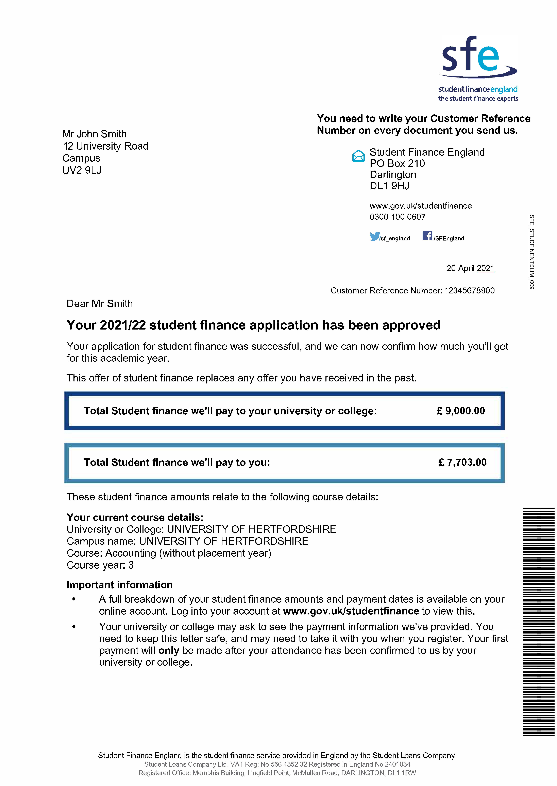
UK Student Finance
Example:
Your tuition fee loan will be paid directly to the University​.
Your maintenance loan will be paid to you in 3 instalments​.
Your entitlement letter from Student Finance will tell you how much maintenance allowance you are entitled to.
Notes:
Once your application has been processed, you should receive your Entitlement letter which will confirm how much Student Finance funding you're entitled to. Undergraduate Student Finance is separated into two different areas; your tuition fee loan and your maintenance loan. Your tuition fee loan will be paid directly to the University, and your maintenance loan will be paid directly to your bank account. The maintenance allowance is paid in 3 instalments across the academic year, in September/October, in January and after Easter. The amount you receive will depend on your household income. Your entitlement letter, which looks like the example on the screen, will tell you how much maintenance allowance you’re entitled to.
For postgraduate students, this is different and so please check the student finance website for accurate information.

Slide 5
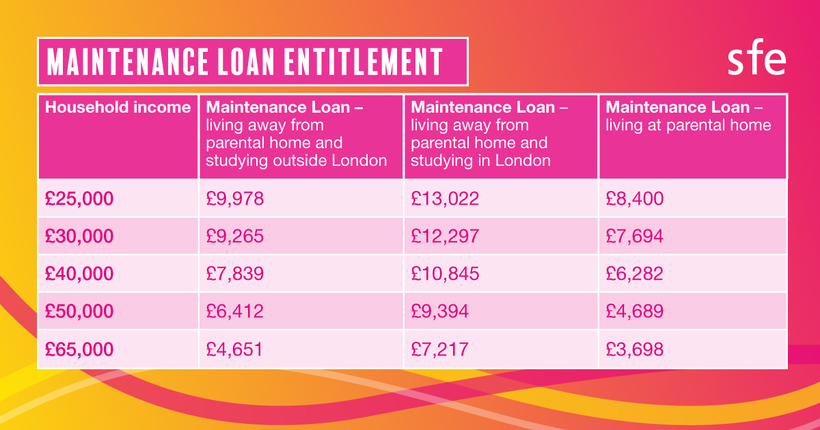
UK Student Finance
(Source: Student Finance England 2023)
Notes:
If you haven’t yet received your entitlement letter, the table on the screen tells you roughly how much you can expect to receive based on your household income.

Slide 6
Student Finance
Students usually receive their first payment from Student Finance towards the end of Welcome Week but it can sometimes take a little longer.​
It's important to make sure you have some savings to support yourself for the first couple of weeks.
If you're experiencing delays with your Student Finance, please contact Student Services.
Notes:
Provided your application has been fully processed, you can expect to receive your first payment towards the end of Welcome Week but it can sometimes take a bit longer. It’s really important to make sure that you have some savings in place to support yourself for the first couple of weeks just in case. If there are any issues in you receiving your Student Finance, please contact Student Finance directly in the first instance and, if you’re still struggling, contact us.

Slide 7
Other funding opportunities
Depending on your course or personal circumstances, you might be eligible for additional funding from the Government:
NHS Learning Support Fund
Parents Learning Allowance
Childcare Grant
Adult Dependent’s Grant
Disabled Students’ Allowance
Find out more:
www.gov.uk/student-finance/extra-help
Notes:
Depending on your specific course and your individual personal circumstances, you may be able to apply for additional funding support from the Government. For example, if you’re studying Nursing, Midwifery, Physiotherapy, Radiography or Paramedic Science, you may be able to receive an additional £5000 from the NHS Learning Support Fund. And for example, if you have children, you may be able to apply for the parents learning allowance and childcare grant. If you think you fall into any of these categories, please look on the Government website for more information about the eligibility criteria and how to apply.

Slide 8
Bursaries and scholarships
You can find a full list of the scholarships and bursaries that Keele University offers on our webpages, along with the eligibility criteria.
Our main bursaries and support funds are:
Keele University Bursary (automatically awarded)
Care Leaver and Estranged Student Bursary (please contact us)
Access & Success Fund (applications will open in December)
You don't need to apply for the main Keele University Bursary, this will be paid automatically if you meet the eligibility criteria.
Notes:
Like many other unviersities, Keele offers some bursaries and scholarships. Our main bursaries for 2023 entry are our Keele University Bursary for students from low income households, and our care leaver and estranged student bursary. You can find a full list of all of our scholarships and bursaries, including School-specific awards, on our webpages along with the eligibility criteria for each.
For the main Keele University Bursary, you do not need to apply for this, it will be paid to you automatically if you meet the eligibility criteria.

Slide 9
Student current accounts
Student current accounts usually have particular benefits for students, such as an arranged overdraft.
Some student current accounts also offer freebies as incentives to switch.
Some have a 0% arranged overdraft facility.
You can compare student bank accounts on sites such as Save the Student or Money Saving Expert.
(Source: Save the Student)
Notes:
As a student, you will be able to apply for a student-specific current account. Student bank accounts usually have benefits such as an arranged overdraft which can be particularly beneficial to students. Some student bank accounts also have freebies as incentives to switch to them. It can be really useful to have access to an arranged overdraft as a student as this is an easy way to borrow money if you’re struggling for cash until you receive the next Stdent finance maintenance allowance instalment.
Here are some examples of the benefits of some student current accounts available this year. It’s important to look at the eligibility criteria – for example, some banks will only allow you to switch if you’re in your first year so it’s worth looking now rather than leaving it to the future. Have a look online at the different accounts – there will be others that aren’t included on this slide.

Slide 10
Student current accounts
The most important factor:
How easy will it be to manage your money effectively?
(Source: Natwest, other banks are available)
Notes:
A question we get asked quite frequently during welcome period is, what’s the best student bank account to get. The most important factor when looking for a student bank account isn’t the freebies or how funky the card looks. The most important factor is, how easy will it be to manage your money effectively. Look on the app stores to see screenshots of what the apps look like, how easy is it to transfer money to a different account? Can you set a budget within the app? Can you keep track of your spending on different categories? Can you set savings goals? And the thing that many people forget, can you freeze your card on the app if you lose it in the Student Union?

Slide 11
Overdrafts and credit cards
There are both positives and negatives of overdrafts and credit cards.
They can be really useful if you need to borrow money in the short-term, but it’s important to avoid relying on them.
There are useful guides on overdrafts and credit cards on the Blackbullion financial education portal.
If you find that you’re starting to accrue debt through credit cards, overdrafts or loans (including BNPL, e.g. Klarna), please reach out for support.

Slide 12
Budgeting
It’s important to learn how to budget effectively to make sure you can meet all your expected costs (and unexpected ones too).​
Budgeting is a skill that you can develop during your time at university, which you will use throughout your life.​
Building a budget (and sticking to it) is a great way of keep on top of your money. Being organised will ensure that you don’t run out of money in the first few weeks.
Notes:
Budgeting effectively means that you can identify shortfalls in advance and plan accordingly to make sure that you can meet all of your upcoming costs. Budgeting isn’t something that comes naturally to everyone – it’s a skill that you can develop over time. University is a great time to learn how to budget and you’ll use the skills you learn for the rest of your life. Start planning your budget now to make sure that you don’t run out of money within the first few weeks.

Slide 13
What should I budget for?
There are a variety of living costs that you will need to consider while at university. These could include:
Accommodation
(rent / mortgage)
Food and toiletries
Household bills
(if applicable)
Clothes
Travel
Laundry
Course materials
(e.g. printing, books...)
Laptop
Notes:
This might be your first time living away from home, and so there may be things you’ve not yet thought about when it comes to knowing what to budget for. There are a range of living costs that you will need to consider while at University, and these might depend on your individual circumstances.

Slide 14
What should I budget for?
You will also need to budget for the non-essential things. These could include:
Meals out and takeaways
Gym membership
Subscriptions
(e.g. Netflix, Xbox Live...)
Beauty treatments
Premium clothing
Leisure
(e.g. nights out, cinema...)
Holidays
Phone contract
Notes:
When building a budget, people often remember to include all of the essentials but forget about the non-essential things that you will inevitably want to spend money on. This doesn’t mean that you can’t spend money on these things – it just means that you will need to prioritise and adapt your budget accordingly. Here are some examples of the non-essential things that you may want to include in your budget

Slide 15
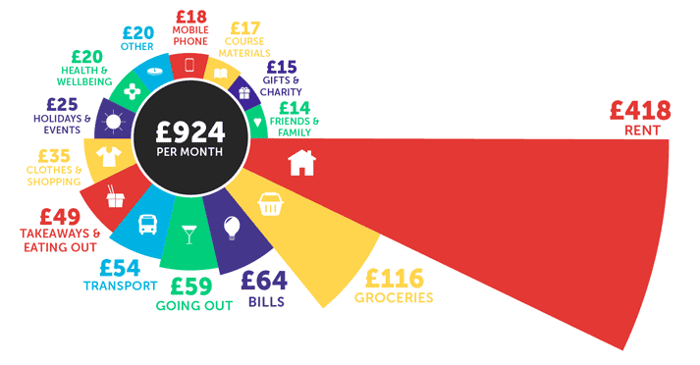
How much do students spend?
The National Student Money Survey 2022 asked students at universities across the UK to estimate how much they spent on different categories each month. The average student spends…
(Source: Save the Student)
Notes:
It can be useful to reflect on what other students spend money on in order to estimate how much you might want to budget for. The National Student Money Survey asks students across the country to estimate how much money they have spent per month on different categories. These are the 2022 results. Each student’s circumstances will be different and so it’s important to build a budget for your individual lifestyle. As you can see, different people will prioritise different things when it comes to spending; one student might prefer to order a takeaway every weekend, whereas another might prefer to spend money on a higher spec phone contract.

Slide 16
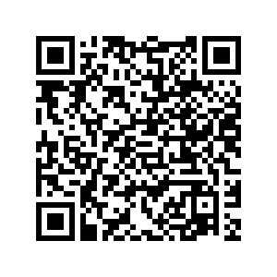
How to build a budget
Since maintenance loans are paid in only 3 instalments across the year, it can be difficult to plan your finances around this.
Our free budget planner helps you to break down your expected income and expenditure across the year to help you to identify financial difficulties in advance, so that you can make changes and seek support in advance.
Scan the QR code to save the webpage and download it later:
Or head to:
https://www.keele.ac.uk/students/studentfinancialsupport/makingthemostofyourmoney/
Notes:
Now that we’ve covered the basics of budgeting, you will be able to start to build your own budget. As a Keele student, you will have free access to the Blackbullion platform – you will just need to register with your Keele email address and verify your email. Perhaps after this session, or later this week, you can take some time to register on the platform and create your own budget. Once you’ve registered, creating a budget on Blackbullion can take as little as 10 minutes and can save you lots of worry later down the line.

Slide 17
How to build a budget
Once you’ve created your budget, you will be able to see whether your finances are balanced, your annual map and comparisons against average student spend.
If your income if less than your expenditure, then you will need to make changes to keep your finances balanced by increasing your income and cutting your costs.
Notes:
Once you’ve inputted your estimates into Blackbullion, you will be ablet o see whether your finances are balanced or not. Blackbullion will tell you if your expenditure is likely to be higher than your income – if this is the case then you will need to take action to increase your income and cut your costs. Instead, if your finances are balanced, you will be able to screenshot your Blackbullion budget to refer to during the year – you might even want to use the figures to put into your banking app if this is a feature.

Slide 18
Increasing your income
You may want to speak to your family to see whether they would be able to contribute to your living costs.
There are a number of opportunities for work within the University such as working for the Student Union and working as a Student Ambassador.​
There are also lots of casual and part-time roles available in the local area.​
Part-time and casual work not only brings additional income but develops more skills to enhance your employability.
Notes:
Maintenance allowance is means-tested and so the amount you receive is dependent on your household income. This is because the higher your household income, the more money the Government assumes your family can afford to contribute towards your living costs. This may not be the case, but you can discuss this with parents to ask whether they would be able to help. Another way to increase your income is to get a part-time job alongside your studies – this is something we would encourage all students to do. Part time and casual work not only increases your income and can help you to become financially stable, but it can also develop your skills and enhance your employability after university. There are a number of different opportunities for work within the University, and you can also look on the Keele Careers Online Hub or on search sites like Indeed to find part time work in the local area.

Slide 19
Cutting your costs
Take a look down your budget and for each cost, consider whether it is a need or a want.
For all of the things that you need, explore whether there is a cheaper alternative. There are some fantastic examples on Save the Student and Money Saving Expert.
For all of the things that you want but don’t need, consider whether you could either cut this out, or reduce your spend.
Take a look at some of the digital resources on the Student Financial Support webpages for more money-saving tips.
Notes:
You may also want to consider cutting your costs. Take a look at your budget and for each costs, try to reduce the spend or find a cheaper alternative. For example, if you’ve estimated that you will spend £100 per month on clothes, you may need to consider reducing this in your budget. Here are some examples of how you can cut your costs while at university.

Slide 20
Small sacrifices for big rewards
Cancel your subscription to Netflix or Disney+
Save £8/month, or £96 over a year
Reduce your phone contract by £20 a month​
Save £20 per month, or £240 over a year
Sacrifice one takeaway a week for a year​
Save £15 per week, or £780 over a year
How would you spend the savings?
Notes:
It’s often not about the big things – it’s the small things that really make the difference. If your phone contract is quite expensive, consider whether you really NEED that much data per month and contact your network provider to discuss the possibility of reducing your tariff. If you reduced your phone contract by £20/month, you would save £240 over the year. Some networks even provide a student discount which could reduce it further.
Another example is the weekly takeaway that many of us are guilty of. Think about whether you really NEED that Friday night takeaway or whether you could make a fakeaway at home with the food in the cupboard that might otherwise end up being wasted. If you gave up that £10 Friday takeaway every week for a year, you would save a huge £520.
These are small sacrifices for some big rewards – and that’s exactly what effective budgeting is about.

Slide 21
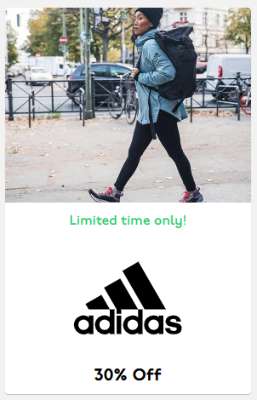
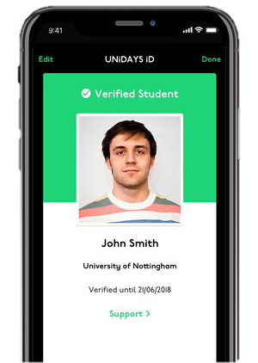
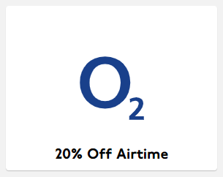
Student discount
Notes:
Lots of places will offer a student discount, but you don’t necessarily need to buy a student card to access them. You can create a Unidays or Student Beans account for free, and there are a number of great discounts available in a wide range of stores. Just remember – just because it’s discounted doesn’t necessarily mean you should buy it.

Slide 22
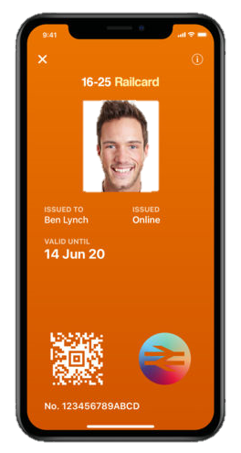
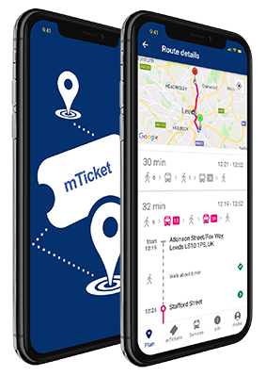
Student travel cards
16-25 Railcard
£30/year
1/3 off rail fares across Britain
Can also be loaded onto a plastic Oyster card
First Potteries Bus Pass
£3.50 for a day pass
£12 for a week pass
£42 for a month pass
Notes:
Students can also access cheaper travel. Have a look online to find further info about public transport discounts.

Slide 23
Budgeting techniques
Once you’ve built a realistic, achievable and balanced budget, the next step is to look closely at how to manage your money. This will help you to stick to your budget.
As a student, it can be really tough to manage your money week-to-week or month-to-month, since your Student Finance maintenance loan is paid to you in only 3 instalments across the year.
We’ll explore two budgeting techniques together:
Piggy-banking
Drip-feeding

Slide 24
Piggy-banking
Piggy-banking is a great budgeting technique that lots of students use very effectively.
It involves using a multiple ‘piggy-bank’ bank accounts or digital ‘pots’ that you transfer money into from your main account, reflecting the amounts in your budget. You would only use your ‘groceries pot’ for groceries, and only use your ‘leisure pot’ for leisure. This way, you wouldn’t be able to accidentally spend money from your groceries budget on leisure activities.
If you use an online bank such as Monzo or Starling, you can set up digital ‘pots’ within seconds in app.
Piggy-banking helps to create a more physical budget so that it’s easier to stick to.

Slide 25
Piggy-banking
Main account
Food
Bills
Entertainment
Savings
Notes:
Let’s visualise it.

Slide 26
Piggy-banking
Main account
Food
Bills
Entertainment
Savings
Notes:
Now that the money is in the different piggy-bank accounts, you could spend all of the money in your entertainment account without impacting on the money you have set aside for food and bills. Your savings are also still there for those unforeseen emergencies.

Slide 27
Drip-feeding
Drip-feeding is another good budgeting technique to make your money last until your next Student Finance maintenance loan payment.
It involves holding two bank accounts:
Your main student bank account, where your Student Finance is paid to.
A second bank account which you would use for all of your living costs.
You could transfer money into your second account weekly or monthly using a standing order. You could even combine drip-feeding with piggy-banking.
Drip-feeding helps to make sure that you don’t spend all of your money at once, and stretches out your Student Finance until the next payment date.

Slide 28
Financial support
Our Student Financial Support team offer confidential, non-judgmental advice and guidance about a variety of financial issues:
UK Government funding
Alternative funding sources
Bursaries and scholarships
Budgeting
Financial support for students facing financial hardship
International student funding (including US federal loans)
You can contact us via Student Services.
Notes:
While you’re at Keele, you’ll be able to access support from our Student Financial Support team. We offer confidential, non-judgemental advice and guidance about a variety of financial issues. You can contact us through Student Services – we’re available through email and through virtual and face to face appointments.

Slide 29
Financial support
Emergency loans
Hardship Fund
1-2-1 Financial Wellbeing Checks
Notes:
We also have financial support available to students experiencing unforeseen urgent or sever financial hardship. If you find yourself facing a sudden, unforeseen emergency which requires money you don’t have immediate access to, we may be able to support you with a small, short-term, interest-free emegerncy loan.
In addition, any Keele student is able to apply for our Hardship Fund if they find themselves experiencing severe financial hardship, and have exhausted all other financial support. You can find out more information on our webpages, including the eligibility criteria.
It’s really important that you reach out for support as soon as possible if you’re starting to struggle financially.

Slide 30
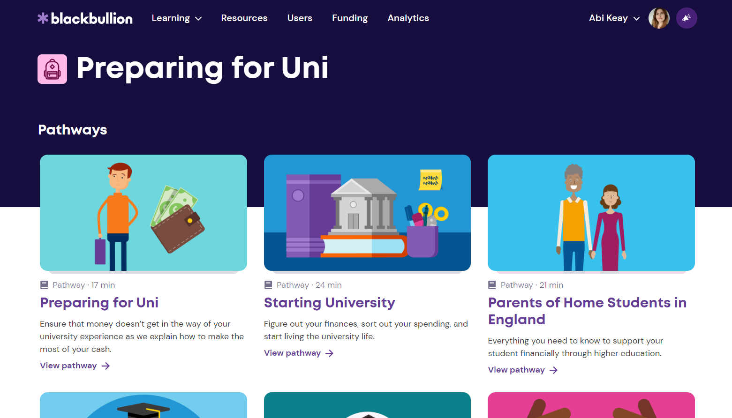
Blackbullion learning platform
www.blackbullion.com
Notes:
We briefly touched on Blackbullion earlier in this talk, and wanted to stress how useful the platform is. Blackbullion is filled with lots of useful information and guidance about all things money-related. These are just some of the short courses and articles available on the Blackbullion platform which ar e particularly useful as you start your university experience. You might want to take a look at these before you start your course.

Slide 31
Tips from current students
"Make sure you have something to eat before you go food shopping so you're less likely to buy snacks while you're there"
"Make a shopping list so that you only buy what you need"
"Buy own brand food – it tastes the same and is usually loads cheaper"
Notes:
Here are some tips from our current students.

Slide 32
Tips from current students
"Buy clothes from affordable shops because they look just as good as designer clothes. And set yourself a limit when you go clothes shopping"
"Sell your old stuff on sites like Vinted or eBay rather than having loads of clothes, phones or games you don't use anymore"
"Buy second-hand games and consoles instead of buy brand new"

Slide 33
Tips from current students
"Buy a travel mug so you can make coffee at home rather than buying one everyday from a coffee shop"
"Buy a little lunch box that you can put some snacks in to take with you to places rather than buying snacks while you're out"
"Don't be scared to say no if your friends ask you to go out and you don't have much money left. One night out isn't going to be worth struggling for the rest of the semester"

Slide 34
Q & A
Need advice and support?
Financial Support Team
student.services@keele.ac.uk
Notes:
And now over to you. Do you have any questions for us? Please post your questions in the chat.

